Slide 1

CONNECTFARMA
Bringing farms to families

Slide 2
INTERNAL PROJECT REPORT
Submitted to: Department of Computer Applications
College Name: JG University
Course: BCA Semester 5
Class Mentor: Javani Shah
Designed by:
1. Jeet Gandhi (1017)
2. Divy Rawal (1052)
3.Prince Savaliya (1061)
4. Kavya Sevak (1062)
5. Saiyam Shah (1064)

Slide 3
Project Overview
Title: ConnectFarma
Tagline: Bringing Farms to Families.
Project Type: In-House
Technology Stack: Frontend: HTML, CSS, JAVASCRIPT
Backend: PHP/Python
Database: MySQL

Slide 4
 | Index
Sr No | Section Title | Page No.
0.1 | Cover Page & Submission Details | 1
0.2 | Project Overview | 2
0.3 | Index (Basic Table of Contents) | 3
1.1 | Project Proposal & Planning | 4
1.2 | Advantages of ConnectFrama | 5
1.3 | Proposed System & Modules Overview | 6
2.1 | System Design & Database | 7
2.2 | System Diagram | 8
2.3 | System Design Layout: Home Page | 9
2.4 | UI Screens: SignUp/Login (Consumer & Farmer) | 10
2.5 | Database Development – Consumer Table | 23
2.6 | Database Development – Farmer Table | 24
2.7 | Database Development – Product Table | 25
2.8 | Modules Summary (Farmer, Customer, Admin, Order) | 26
2.9 | Functional Details (User Registration, Login, Listing, Orders) | 27
2.10 | Dashboard Features (Admin, Farmer, Consumer) | 28
2.11 | Contact & Support + Final Flow Diagram | 29
3.1 | Use Case Diagram – Consumer Table

Slide 5
Project Proposal & Planning

Slide 6
1.Project Title:
ConnectFarma – A Local Farmers Market Website
2. Problem Statement:
  a) Farmers face challenges in connecting directly with urban consumers due to the lack of digital platforms. This allows middlemen to take advantage, increasing their profits and selling products to consumers at a higher price. There is a need for a transparent, user-friendly platform to bridge this gap and facilitate direct transactions.
3. Existing System and Limitations:
  a) Offline Markets: Time-bound, location-specific, and lack reach.
  b) Existing Apps: Target large-scale agriculture or wholesalers, not local farmers.
Limitations include:
a) No direct communication channels between farmers and buyers.
b) Lack of trust and verification.
c) Poor UI for illiterate farmers.

Slide 7
Additionally, Platforms like Blinkit, Swiggy Instamart, and Zepto also offer vegetable and fruit delivery services. However, these services often encounter quality issues because their core business models are not centered around fresh produce.
Since selling vegetables does not generate high profits for these companies, they do not focus significantly on improving quality or supply chain efficiency in this area.
ConnectFarma is specifically designed for selling vegetables and fruits. Our platform directly involves local farmers in managing their inventory, ensuring freshness, accountability, and transparency. This farmer-centric model eliminates intermediaries, placing quality control in the hands of those who grow the product.
ConnectFrama aims to be a niche platform dedicated to vegetables and fruits—an area currently underserved by mainstream delivery apps.
Advantages of ConnectFrama:
1. Direct Farmer-to-Consumer Link
Farmers can sell their produce directly to customers without middlemen, ensuring better profits.
2. Fresh and Quality Produce
Since farmers manage their own stock, customers receive fresh fruits and vegetables with assured quality.
3. Fair Pricing
Eliminating intermediaries results in transparent and reasonable pricing for both farmers and buyers.
4. Focus on Fruits & Vegetables Only
Unlike other platforms, ConnectFrama is fully dedicated to the fruits and vegetable segment, ensuring specialized service.

Slide 8
5. User-Friendly Platform
Designed with simplicity in mind for both farmers and consumers, including easy registration and order management.
6. Community Empowerment
It supports local agriculture, boosts farmer income, and promotes healthy eating in urban areas.
Key Features & Functionalities:
Farmer Portal: Register, upload products, update stock/pricing.
Customer Portal: Browse, filter, search, and place orders.
Admin Panel: Manage users, products, and handle disputes.
Order System: Cart, payment, and delivery tracking.

Slide 9
System Design & Database Development & Data Dictionary

Slide 10
System Design
Module And Sub-Module
Module | Sub-Module
Farmer Module | Registration , Login , Product Upload
Consumer Module | Registration , Product Browsing , Add to Cart , Place Order
Admin Module | Approved Users , View Reports , Manage Listings
Order Module | Invoice Generation , Status Updates

Slide 11
1. User Registration (Consumers & Farmers)
Allows both consumers and farmers to sign up by providing basic details like name, email, contact number, and password. Validates input and securely stores user data in the database.
2. Login & Authentication
Enables registered users to log in securely. Authenticates credentials and manages user sessions to personalize access to features.
3. Product Categories
Displays farm product categories like fruits, vegetables, dairy, etc., with images and descriptions. Helps users easily browse what’s available.
4. Product Listing & Details
Farmers can upload products with names, prices, and images. Consumers can view product details, availability, and prices before ordering.
5. Order Placement & Cart
Consumers can add items to their cart, review the list, and place an order. The cart system helps manage multiple items and total cost calculations.

Slide 12
6. Admin Dashboard
Provides control to monitor users, products, and orders. Admin can approve farmer accounts, manage data, and ensure smooth operations.
7. Farmer Dashboard
Farmers can manage their profile, add or edit product listings, and track orders received. It simplifies their selling process.
8. Consumer DashBoard
Consumers can view past orders, track current ones, and manage their profile. Gives a clear overview of their buying activity.
9.Contact & Support
A contact page for consumers or farmers to raise questions or concerns. Ensures good communication and trust in the platform.

Slide 13
System Design

Slide 14
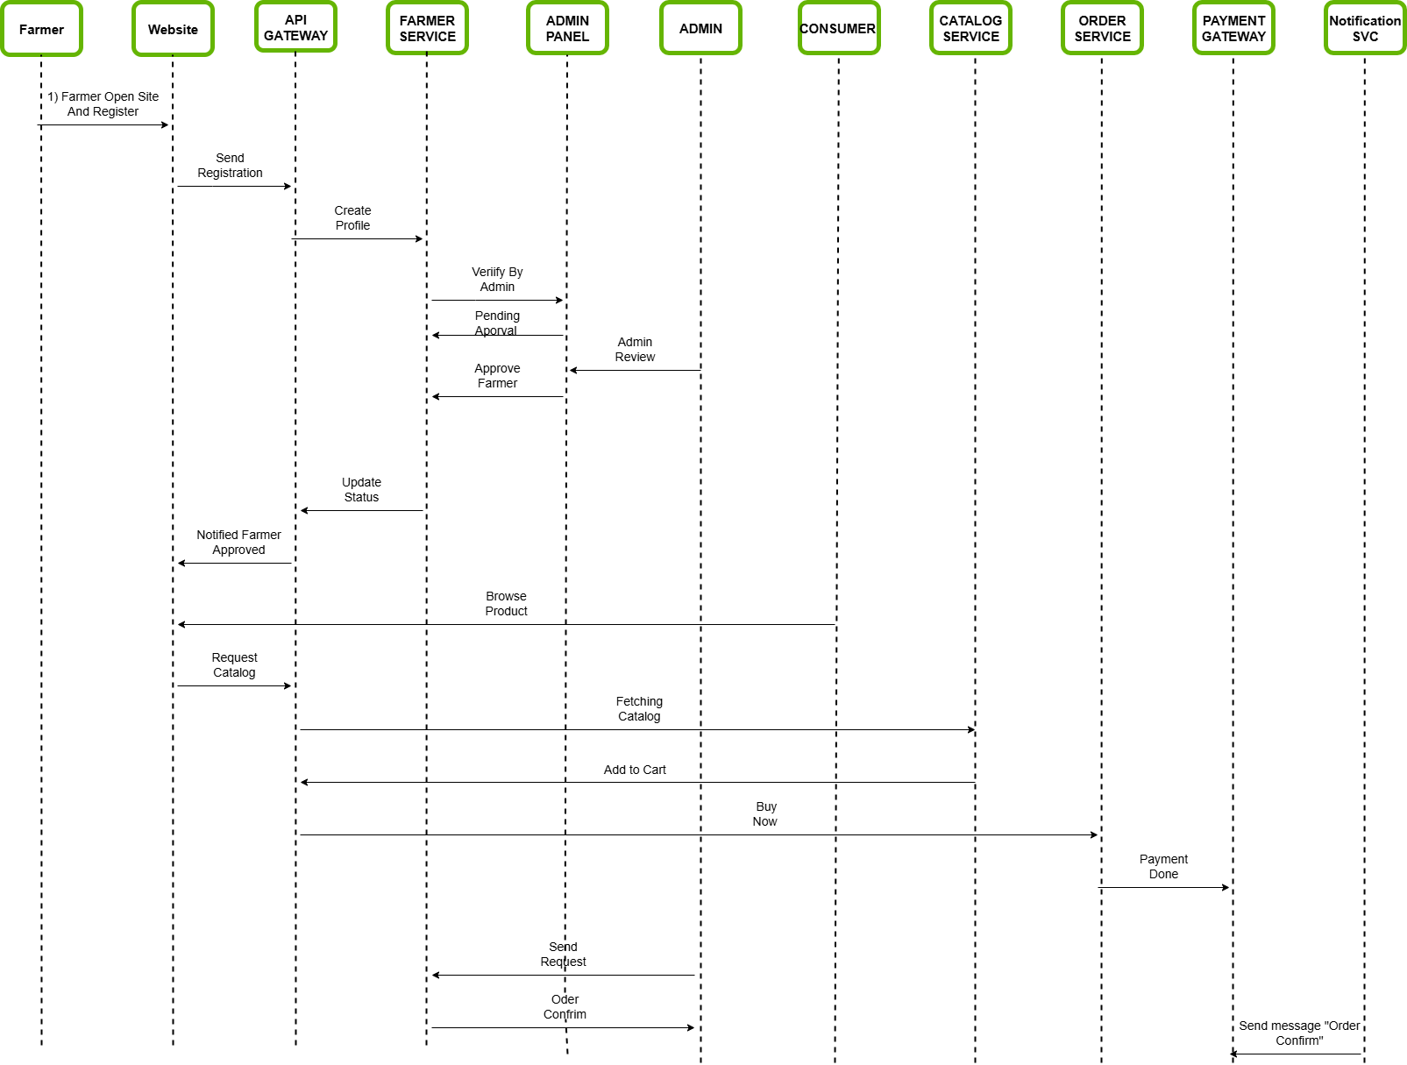

Slide 15
Database Development

Slide 16
Entity Relationship Diagram

Slide 17
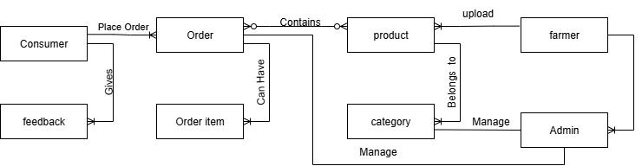

Slide 18
Database Dictionary

Slide 19
Consumer Table
Column Name | Data Type | Data Size | Constrains | Description
Consumer_id | Int | 11 | Primary Key | Unique ID for each consumer
Name | Varchar | 30 | Not Null | Name of consumer
Email | Varchar | 30 | Not Null | Used for login & contact
Contact No | Int | 10 | Not Null | Phone number for contact
Password | Varchar | 100 | Not Null | For secure login

Slide 20
Farmer Table
Column Name | Data Type | Data Size | Constrains | Description
Farmer_id | Int | 10 | Primary Key | Unique ID for each farmer
Kisan_id | Int | 13 | Not Null | Govt ID for farmer verification
Name | Varchar | 50 | Not Null | Name of farmer
Email | Varchar | 50 | Not Null | For login or communication
Contact No | Int | 10 | Not Null | Farmer’s phone number
Pincode | Int | 7 | Not Null | Farmer’s area code
Village | Varchar | 100 | Not Null | Farmer’s village location
Password | Varchar | 100 | Not Null | For secure login

Slide 21
Admin Table
Column Name | Data Type | Data Size | Constrains | Description
Admin_id | Int | 4 | Primary Key | Unique identifier for each admin
Username | Varchar | 50 | Not Null | Login name chosen by the admin
Password | Varchar | 255 | Not Null | Stores the admin’s hashed password

Slide 22
Category Table
Column Name | Data Type | Data Size | Constrains | Description
Category_id | Int | 4 | Primary Key | Unique ID for each category
Product_id | Int | 4 | Foreign Key | Links the category to a product
Category_name | Varchar | 100 | Not Null | Name of the category

Slide 23
Product Table
Column Name | Data Type | Data Size | Constrains | Description
Product_id | Int | 10 | Primary Key | Unique ID for each product
Product_name | Varchar | 100 | Not Null | Product name or title
Product_price | Int | 4 | Not Null | The selling price of the product
Product_weight | Int | 4 | Not Null | The weight of the product
Farmer_id | Varchar | 10 | Foreign Key | Links product to farmer

Slide 24
Order Table
Column Name | Data Type | Data Size | Constrains | Description
Order_item_id | Int | 8 | Primary Key | Unique ID for each order item
Product_id | Int | 4 | Foreign Key | Links the order item to a product
Quality | Varchar | 20 | Not Null | Describes the product’s quality

Slide 25
Order Item Table
Column Name | Data Type | Data Size | Constrains | Description
Order_item_id | Int | 8 | Primary Key | Unique ID for each order item
Order_id | Int | 4 | Foreign Key | Links the item to a specific order
Quantity | Int | 3 | Not Null | Number of units of the product in the order

Slide 26
Feedback Table
Column Name | Data Type | Data Size | Constrains | Description
Feedback_id | Int | 8 | Primary Key | Unique ID for each feedback entry
Consumer_id | Int | 4 | Foreign Key | Identifies which consumer submitted the feedback
Message | Varchar | 500 | Not Null | The feedback text written by the consumer

Slide 27
Flow Diagram

Slide 28
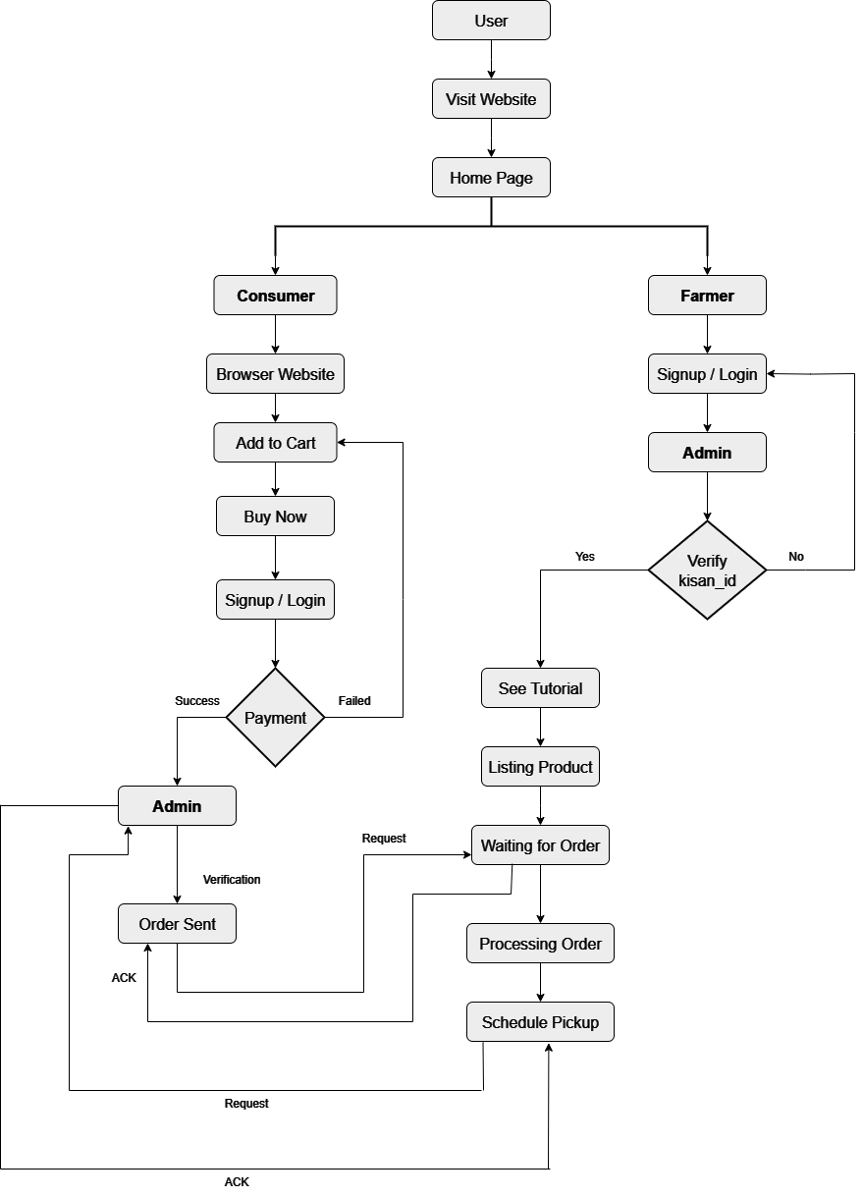

Slide 29
Unified Modelling Language

Slide 30
Use Case Diagram

Slide 31
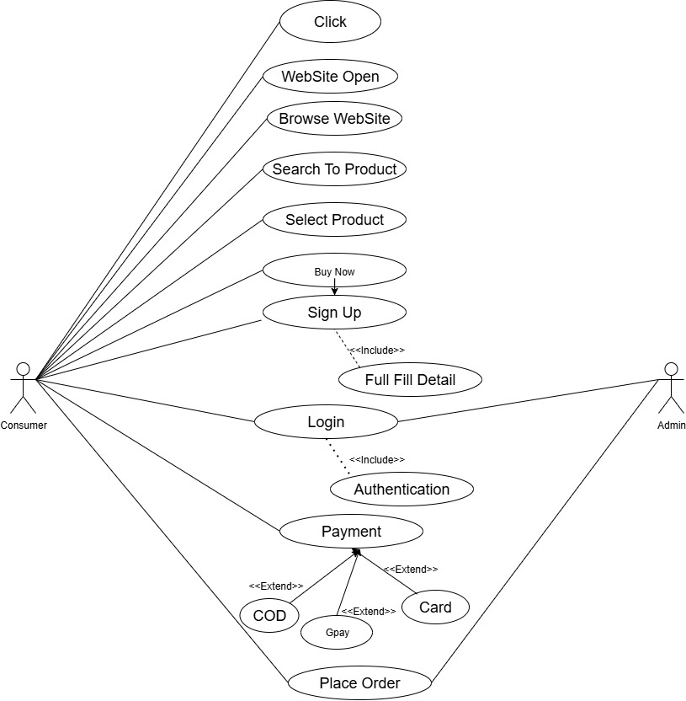
Consumer Table

Slide 32
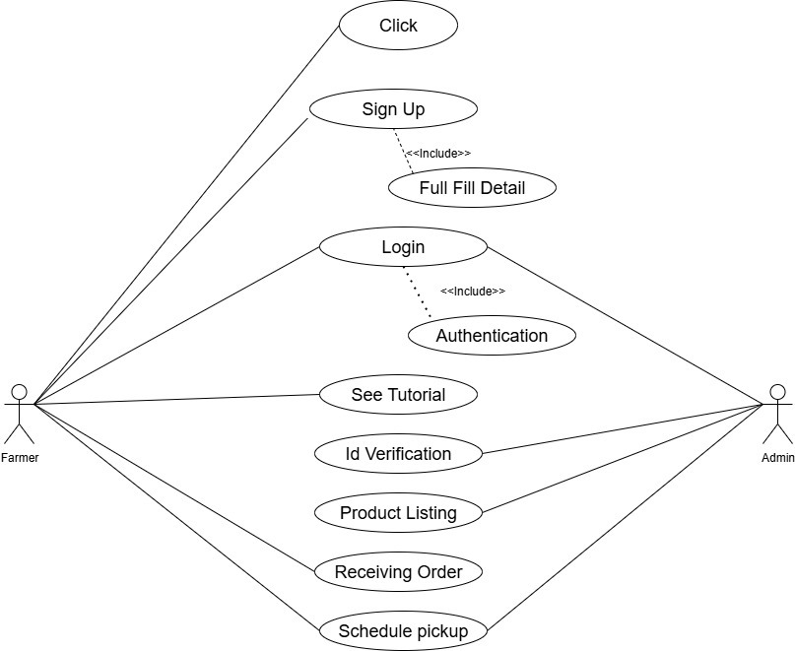
Farmer Table

Slide 33
Activity Diagram

Slide 34
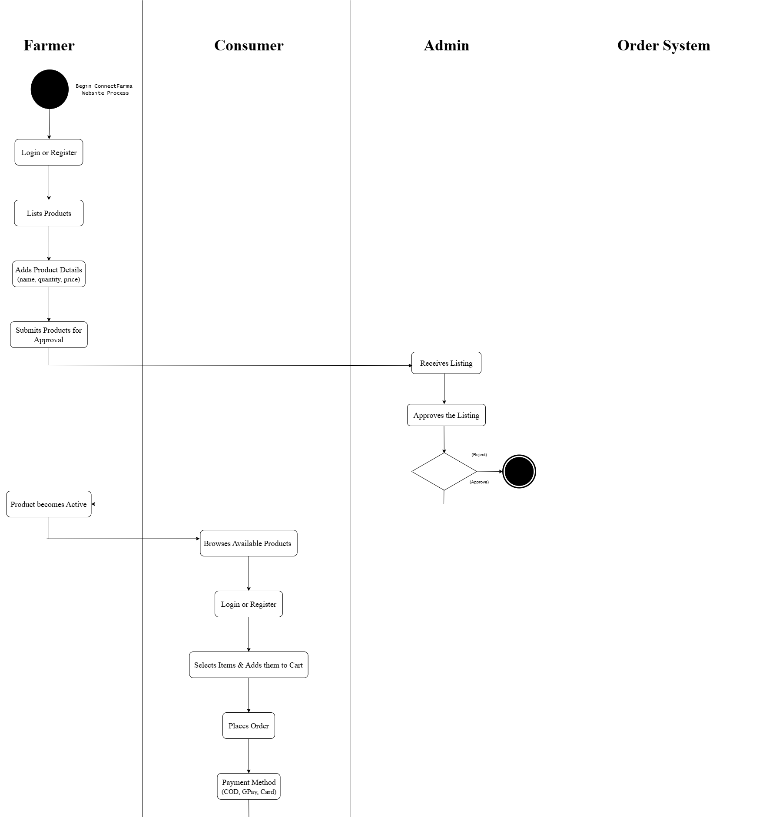

Slide 35
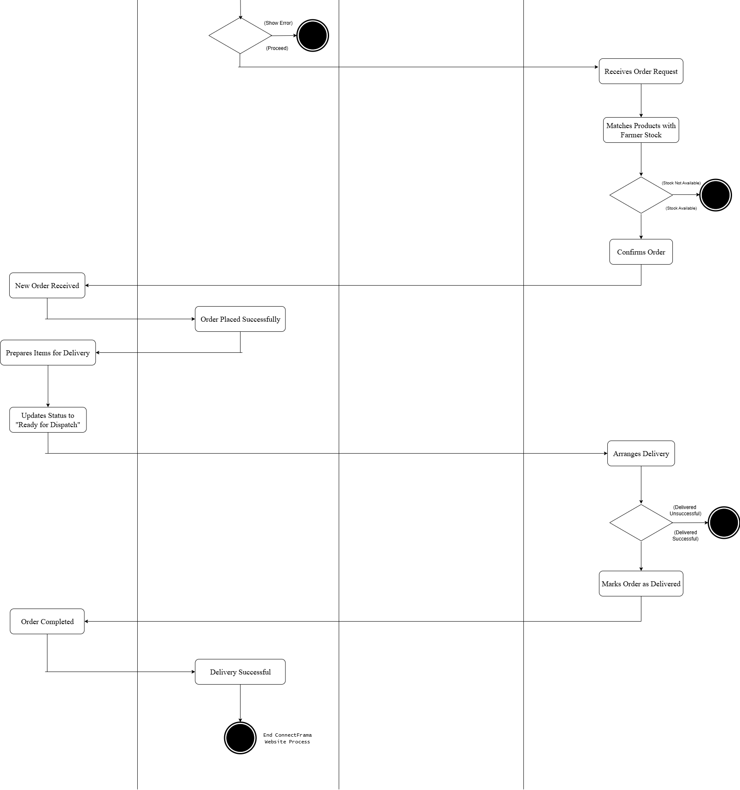

Slide 36
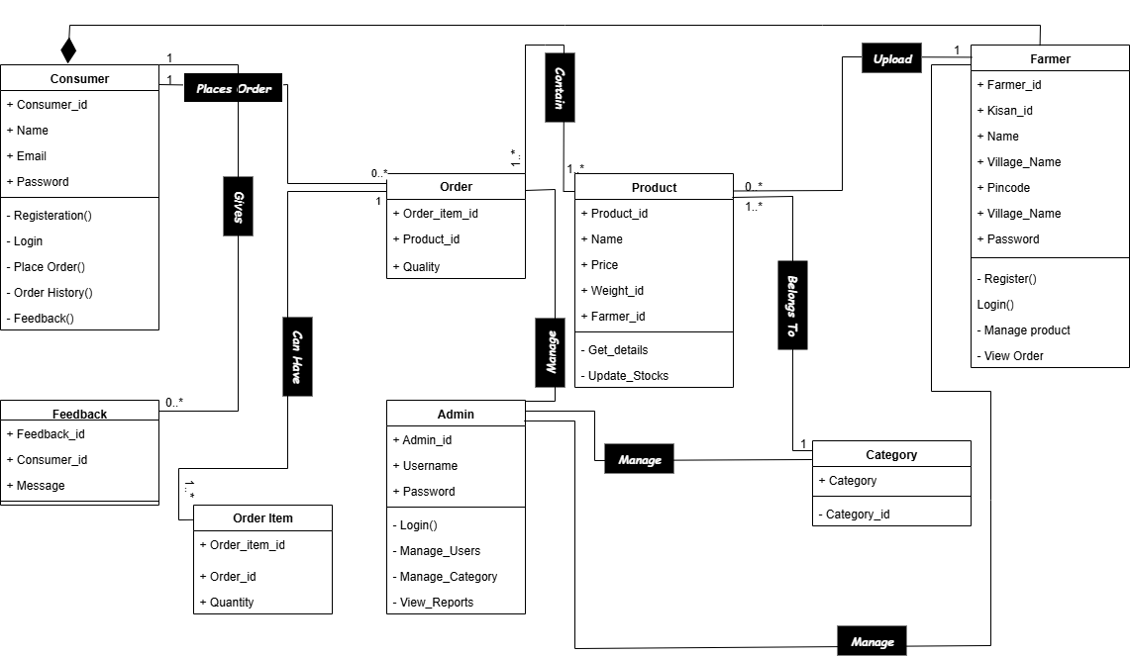
Class Diagram

Slide 37
Proposed System
1) High Quality Products: Customers will always get fresh, organic, and high quality fruits and vegetables directly from trusted sources.
2) Reasonable Pricing: Products will be offered at affordable and competitive Prices so that everyone can access healthy food.
3) Fair pricing for All: This system benefits both customers and farmers by ensuring fair and transparent pricing

Slide 38
Scope
The scope of Connect Farma is to build a seamless and reliable e-commerce platform dedicated to the daily supply of fresh fruits and vegetables, similar to the “Milk Basket” model. The system focuses on convenient doorstep delivery, allowing customers to receive fresh produce daily or as per their chosen schedule. By integrating features such as subscription-based services, flexible delivery slots, and user-friendly online ordering, the platform aims to become a trusted source of essential fruits and vegetables for urban as well as semi-urban households. Furthermore, Connect Farma creates opportunities for farmers to directly connect with consumers, ensuring better earnings, reduced wastage, and fair pricing. In the long run, the platform has the potential to expand into other daily essentials, thereby strengthening its market reach and customer base.

Slide 39
Tools and Technologies
1. HTML (Hyper Text Markup Language) – Used for creating the structure of the Connect Farma web platform.
2. CSS (Cascading Style Sheets) – Applied to design and style the user interface for a clean and user-friendly experience.
3. JavaScript (JS) – Implemented to add interactivity and dynamic features, enhancing the overall functionality of the platform.
4. Python – Used for backend development, handling business logic, and managing data processing.
5. Database – Implemented to securely store and manage information related to products, customers, orders, and transactions.

Slide 40
System Requirement
Browser Compatibility
The Connect Farma platform is designed to run smoothly on multiple web browsers for better accessibility and user experience. It supports:
1. Google Chrome – Primary browser for testing and running the application.
2. Mozilla Firefox – Ensures compatibility and performance across different systems.
3. Microsoft Edge – Provides seamless access on Windows-based systems.
4. Brave Browser – Supports privacy-focused users without compromising performance.

Slide 41
Objective
1. Direct Farmer-to-Consumer Connection – Eliminate middlemen and create a link between farmers and consumers, ensuring fair prices for both sides.
2. Fair Pricing and Transparency – Provide genuine and transparent pricing so that farmers earn more and customers save money.
3. Freshness and Quality – Deliver fresh, healthy, and high-quality fruits and vegetables directly from farms to homes.
4. Convenience in Shopping – Offer a simple, user-friendly online platform with doorstep delivery to save customers’ time and effort.
5. Sustainability – Encourage eco-friendly practices like minimal packaging and reduced food wastage to promote a greener future.

Slide 42
Requirement Analysis
Current System
At present, popular platforms like Blinkit, Zepto, and BigBasket are widely used for the delivery of fruits and vegetables. However, these platforms face several limitations:
1. Higher Pricing – Due to multiple intermediaries, customers often pay more than the actual farm value.
2. Middlemen Involvement – Farmers do not get fair earnings, as a significant share goes to middlemen.
3. Quality Issues – Customers sometimes receive overripe, stale, or low-quality produce.
4. Limited Freshness Guarantee – Many products are stored in warehouses for long durations, which reduces freshness.

